Slide 1
Open Source
Engineering Processes
Prof. Dr. Dirk Riehle
Friedrich-Alexander University Erlangen-Nürnberg
FOSS B05
Licensed under CC BY 4.0 International
Notes:
It is Friedrich-Alexander University Erlangen-Nürnberg – FAU, in short.
Corporate identity wants us to say “Friedrich-Alexander University”.

Slide 2
Open Source Innovation
Legal innovation
Process innovation
Software tool innovation
Business model innovation

Slide 3
Open Source Process Innovation
Community processes
Engineering processes

Slide 4
Open Source Projects (Recap)
Project community
  People and companies engaged with the software
    Includes using, developing, and marketing the software
Software (components)
  Not a product but a component (even if an application)
    Users are therefore best advised to view project as a supplier
Software users
  Natural people scratch their own itch
  Companies embedded software in products

Slide 5
The Software Supply Chain (Recap)
Users
...
...
closed source
product #14387
closed source
product #9263
open source
proj #1522
Project (both supplier and user)
open source
proj #5332
Suppliers
...
...
open source
proj #897
open source
proj #832
open source
proj #21632

Slide 6
Key Roles in Software Engineering
Client-specific projects
  Business analyst
  Project manager
  Software developer
  Software tester / QA engineer
Products for a market
  Product manager
  Engineering manager
  Software developer
  Software tester / QA engineer
Open source projects develop
components for a market

Slide 7
Roles in Open Source Software Projects
Committer
Foundation
Member
explicit promotion
explicit promotion
Contributor
PMC Leader
implicit promotion
explicit promotion
User
PMC Member
from committer

Slide 8
Closed to Open Source Role Mapping
Product manager
Committer
Engineering manager
Contributor
Software developer
User
Software tester

Slide 9
Product Management in Open Source
Strategic product management
  Does not take place in open source, is performed outside
Technical product management
  Product roadmapping
    Some is performed but often is ad-hoc
  Product specifications
    Barely exist as documents (wikis, to-do lists, other)
  Progress tracking
    Managed by time, it is done when it is done

Slide 10
Engineering Management in Open Source
Release planning
  See product management: Some is performed but often is ad-hoc
Resource allocation
  Committers can prod contributors but that’s about it
  Usually contributors pick up what they like to work on
Process improvement
  Ad-hoc, if any

Slide 11
Software Development in Open Source
Programming
  Like in closed source, but in general with less visibility as to completion

Slide 12
Quality Assurance in Open Source
Code review
  Is the core ingrained best practice followed by open source projects
Automated testing
  Like in closed source, though perhaps a bit more ad-hoc in general
Manual testing
  A lot of user testing, significantly more than in closed source
Release management
  Like in closed source, committers play release manager

Slide 13
Two Perspectives on the Discrepancy
It is embarrassing for open source, because
  It often does not know or apply the most basic best practices of product and engineering management
It is embarrassing for closed source, because
  All those best practices don’t seem to matter much: People figuring it out as they go along are equally or more effective
The truth is probably somewhere in between
  As so often, people matter more than processes and tools
  Still, open source projects could learn a lot

Slide 14
Open Source Engineering Innovation
There is no single process, only the one a community adopts
  We can only talk about the 3-4-5 model of open communities
Open source has a strong source code contribution process
  A.k.a. peer review, patch submission, pull requests
Distributed collaboration and version control
  Developed and made popular by open source

Slide 15
The 3-4-5 Model of Open Projects (Recap)
Three principles of open collaboration
  Egalitarian: Everyone may join and contribute
  Meritocratic: Decisions are based on the merits of the argument
  Self-organizing: Projects choose their own process
Four practices of open communication
  Communication in open source projects is open, that is, is public, written, complete and archived
Five stages of project volunteering
  Engagement proceeds through the finding, understanding, engaging, contributing, and leading stages

Slide 16
Contributions to Open Source Projects
Source code contributions
Bug reports using issue trackers
Forum posts and answers
Conference presentations, etc.

Slide 17
Roles in Open Source Projects (Recap)
Has commit (write) rights
Performs bulk of the work, patch review
Committer
explicit promotion
Provides small features, bug fixes
Submits patches (no commit right)
Contributor
implicit promotion
Knows and uses software
If so, helps with comments, feedback
User

Slide 18
Source Code Contribution Process
Planning of contribution by contributor
Creation of original source code by contributor
Submission for inclusion by contributor
Review with possible back-and-forth by committer
Commit to code repository by committer

Slide 19
1. Planning of Contribution by Contributor
A developer in the contributor role suggests a feature
  Sometimes, committers will prod contributors for features
The smart contributor lays out what needs to be done
  Includes angle of attack, design issues and solutions
  Perhaps provides time-line, need for coordination
  Seeks, accepts, and works with project feedback

Slide 20
2. Creation of Contribution by Contributor
The contributor develops the code

Slide 21
3. Submission of Contribution by Contributor
The contributor submits the code for consideration
  There are two common forms of submitting code:
    Patch submission by email (the original method, still widely used)
    Pull request using distributed version control systems

Slide 22
4. Review of Contribution by Committer
A developer in the committer role reviews the code
  If the contribution lacking, a back-and-forth ensues
    If unanswered, the contribution might be dropped

Slide 23
5. Commit of Contribution by Committer
The committer commits the source code

Slide 24
Patch Submission using diff and patch
Contributor “diffs” their working copy with latest relevant version
Submits diff output to committer by email or through bug tracker
Committer uses “patch” to apply contribution to working copy
Committer reviews working copy for committing to project
Committer commits patched version of their working copy

Slide 25
A Simple Diff / Patch Example
dirk@menlopark:~/workspace/jvalue/src/org/jvalue/names/values$
diff AbstractName.java ~/release/.../AbstractName.java > patchfile
219,225d218
< protected void assertIsValidIndex(int i) throws Exception {
< assertIsValidIndex(i, getNoComponents());
< }
<
< /**
< * @MethodType assertion
< */
katja@paloalto:~/myprojects/jvalue/src/org/jvalue/names/values$
patch AbstractName.java < patchfile

Slide 26
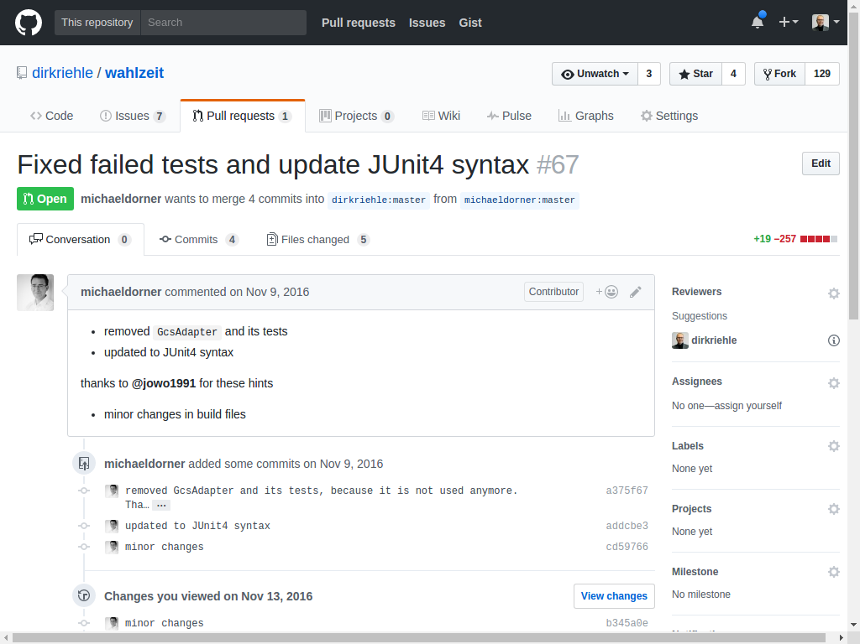
Sending Merge Requests (Pull Requests)

Slide 27
Successful Contribution is Difficult
Submissions by contributors often don’t make it
  The not-so-smart contributor ...
    Did not coordinate with the project in advance
    Does not understand and comply with project practices
    Misses the right time window
  The committer might reject the submission because ...
    The contributor does not follow-up properly upon a critique
    The submission is too difficult to review (e.g. too large [W+08])
  No committer has time to review the submission

Slide 28
Three (Very Different) Process Examples
The Linux kernel
  An operating system kernel
  Hierarchical: “Linus and his trusted lieutenants”
The PostgreSQL RDBMS
  A relational database system
  Core group of committers and evangelists
The Tiki Wiki CMS Groupware
  A web application platform
  Anarchic: (Almost) everything goes

Slide 29

The Linux Kernel
Is a Unix-derived / like operating system kernel
  A kernel provides the core functions of
  an operating system
Is the core of the GNU / Linux operating system
  The operating system adds drivers, tools, etc.
  for a complete system
Is broadly applicable, and widely used
  As an embedded, mobile, desktop,
  and server operating system
Is a unique free software project
  Has more than 5 million lines of code and
  more than 1000 active contributors
  Is GPLv2-licensed with caveats

Slide 30
Motivation for Company Engagement
Motivation to use or build on Linux and the Linux kernel
  Keep proprietary operating systems at bay (cf. business models)
  Be able to deliver products to a large market
Motivation to contribute to Linux and the Linux kernel
  Benefit from the open process, user feedback, improvements, etc.
  Avoid maintenance costs for “out-of-tree” development
  Gain credibility and position to influence future development

Slide 31
Development of the Linux Kernel [C09]
Is supported and guided by the Linux Foundation (LF)
  The LF employs Linus Torvalds, the founder and leader the Linux kernel
Is solidly commercial (i.e. paid employees develop Linux)
Is unique so that generalization is difficult / not appropriate
The Linux kernel process calls committers “maintainers”
“At least 65% of the code which went into 2.6.20 was created by people working for companies.” [C07]

Slide 32
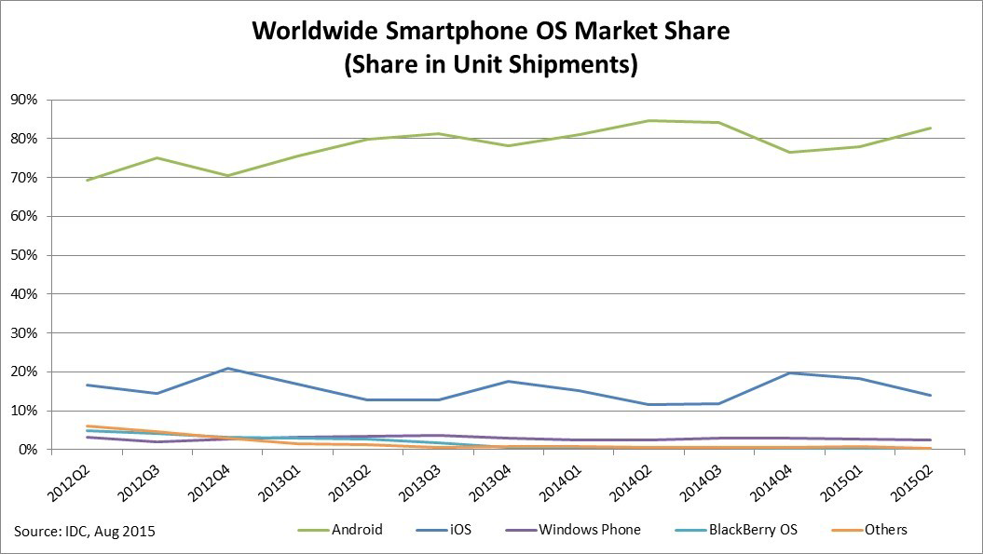
Growth of Linux (by way of Android) [1]
[1] http://www.idc.com/prodserv/smartphone-os-market-share.jsp

Slide 33
Linux Kernel: Product Management
There is no centralized planning or product management
  Individuals and companies decide on what to work on, for example,
    Companies integrate device drivers
    Individuals “scratch their own itch”
  Corbet [C09] doesn’t even talk about it
The Kernel bug tracker can serve as a starting point

Slide 34
Linux Kernel: Engineering Management
The Kernel development time-line
  Is determined and managed by Linus Torvalds (with community)
The Kernel has a major release every two – three months
  Weeks 1 + 2 (merge window)
    Stable code is merged into the mainline
    First release candidate is declared
  Weeks 3 – end
    Fixes to problems with the release candidate are accepted
    New features are rejected / postponed to next merge window
  Final “stable release” is cut
Code (“patches”) is stabilized outside the mainline
  Any contribution (feature, bug fix, etc.) is called a patch

Slide 35
Linux Kernel: Code Architecture Illustration
Kernel
Base
Networking
Device Driver
Memory Manage-ment
...
SCSI Driver
Graphics Driver
USB Driver
...

Slide 36
Linux Kernel: Conway’s Law Applied
Linus
Torvalds
Kernel
Base
David S.
Miller
Greg Kroah- Hartman
Balbir
Singh
Networking
Device Driver
Memory Management
...
Dario
Ballabio
Dave
Airlie
Li Yang
...
SCSI Driver
Graphics Driver
USB Driver

Slide 37
Linux Kernel: Patch-Flow 1 / 3
Preparation of patches outside the mainline for integration
  Design
    Can be done in private, should better be done in public
  Early review
    Patch is posted to (relevant) mailing list, receives feedback
    Feedback ideally unearths any serious problems with patch
    Patch gets reworked until it gets close for mainline inclusion
  Wider review
    Patch is received by relevant subsystem maintainer
    Maintainer applies patch to their (git) staging area
      Exposes patch to even wider audience, leads to more feedback
      Patch may not move on into the mainline during merge window

Slide 38
Linux Kernel: Patch-Flow 2 / 3
Integration of patches into mainline during merge window
  Top-level maintainers ask Torvalds to (git) pull their changes
    Top-level maintainers themselves pulled from lower level maintainers
Final integration decision at tree root by Torvalds
  In practical terms, he relies on his “trusted lieutenants”
    This “chain of trust” can go a few levels deep
  Also implies Torvalds is merging more than programming

Slide 39
Linux Kernel: Patch-Flow 3 / 3
Linus
Torvalds
Kernel
Base
Greg Kroah- Hartman
Device Driver
Random A.
Hacker
Dario
Ballabio
Random B. Hacker
Screw Driver
SCSI Driver
Scuba
Driver

Slide 40
Linux Kernel: Software Development
New code must be formatted according to coding guidelines
  Reformatting old code to conform is considered “noise”
Patch submission should follow several distinct rules
  Break down major changes into a series of smaller patches
  Make each patch semantically self-contained, reasonably small
  Each patch must be able to stand on its now, not break the build
  Describe each patch in the series following Kernel guidelines
After patch submission, the review commences

Slide 41
Linux Kernel: Quality Assurance 1 / 2
Community
Distributor
Community Testing
Closed Test Suites
Developer
Version
Maintainer
Version
Kernel Release
Developer
Reviewed
Quality
Assured
Distribution
Release

Slide 42
Linux Kernel: Quality Assurance 2 / 2
Coding guidelines and good programming patterns
Use of compiler warnings and code-checking tools
Heuristics and advice on testing the kernel by hand

Slide 43

The PostgreSQL RDBMS
Is “the most advanced” open source RDBMS
  Standards-compliant
  Enterprise-ready
  Feature-rich
Has 20 years of active development
  Serves the needs of enterprises
  Serves the needs of individuals
Has broad community support
  Companies contribute for commercial purposes
  Individuals contribute to “scratch their itches”
Is permissively licensed
  PostgreSQL license, similar to BSD / MIT

Slide 44
PostgreSQL: Product Management [1]
Product roadmap is defined by core team [2]
Product backlog is maintained as a to-do list [3]
There is no prioritization: “Pick your feature”
Community uses user polls for market research
[1] http://www.postgresql.org/developer
[2] http://www.postgresql.org/developer/roadmap
[3] http://wiki.postgresql.org/wiki/Todo

Slide 45
PostgreSQL: Engineering Management
Core team (long-term stable six members)
  Coordinate release management activities
  Facilitate consensus building process
  Decide if community consensus fails
  Administer major assets (website, repository)
20+ major contributors (committers)
  Have commit rights, contribute to code base
(Regular) contributors
  Contribute to code base through committers
“Hacker Emeritus” and past contributors

Slide 46
PostgreSQL: Patch-Flow
Patch design
  Can start in private, but is better done publicly
Patch submission
  Should always be submitted to the pgsql-hackers mailing list
Patch review
  Takes place publicly on mailing list
Patch integration
  A committer commits the patch to the git repository
Random A. Hacker
pgsql-
hackers
mailing
list
Committer
pgsql
git-repo
A Patch
The Patch

Slide 47
PostgreSQL: Commitfest 1 / 2
A commitfest is a period of intense patch review and integration
  The purpose is to catch-up with the patch backlog
    Old patches get stale, work is lost
  Commitfests are held every other month and run for a month
    Unless a pending release gets in between and postpones the commitfest
Commitfest roles and activities
  The commitfest manager selects patches for the patch queue
  The commitfest manager assigns patches for review
  The patches are discussed, until reviewers sign off
  “Ready for committer” patches get picked-up, committed

Slide 48
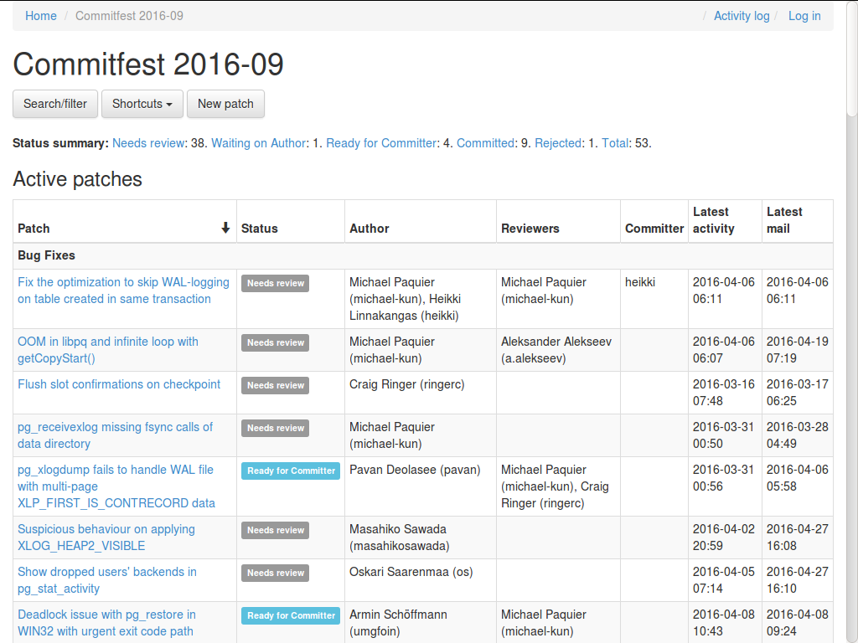
PostgreSQL: Commitfest 2 / 2

Slide 49
PostgreSQL: Software Development
Coding guidelines and good programming patterns
Use of compiler warnings and code-checking tools

Slide 50
PostgreSQL: Quality Assurance 1 / 2
Community
Community Testing
Developer
Version
Committer
Version
Release
Manager
Official
Release
Test Suites

Slide 51
PostgreSQL: Quality Assurance 2 / 2
Defined test suites
  Use of regression test suites
  Performance test suites using industry benchmarks
  Use of closed or open source applications
Provides testing tools
  Isolation tests

Slide 52
PostgreSQL: Release Management
Commitfest
Alpha release
Beta release
Release

Slide 53

The Tiki Wiki CMS Groupware System
A wiki, a CMS, a groupware system
  Web application platform with the most built-in features
  “Everything but the kitchen sink”
In active development since 2002
  With more than 250 contributors

Slide 54
Tiki: Product Management [E09]
No central product management, but shared to-do list
  Anyone can add a feature request
  Anyone can pick a feature to work on

Slide 55
Tiki: Engineering Management 1 / 2
SD
SD
SD
Anyone who asks and seems
like a reasonable person
will get commit access
to the main repository
Contributor recruiting
  “Recruit early,
  recruit often”
  Smart, highly
  collaborative people
Strong code ownership
Tiki
svn-repo
SD
SD
SD
SD
SD

Slide 56
Tiki: Engineering Management 2 / 2
Contributions have to follow these two rules
  “Don’t break anything”
  “Make it optional” (users can switch on/off features)
“Commit early, commit often”

Slide 57
Tiki: Software Development
Tiki has a monolithic software architecture
  No complex plug-in architecture gets in the way
  Contributors can directly change the code
  Avoids “dependency hell”
“If it ain’t broken, don’t fix it”

Slide 58
Tiki: Quality Assurance 1 / 2
bug count
frequency of feature use

Slide 59
Tiki: Quality Assurance 2 / 2
Extensive community testing
  “Given enough eyeballs, all bugs are shallow”

Slide 60
Review: Product Management
No central control, no single responsible product manager
  Companies contribute in line with their own interests
  Individuals contribute to scratch their own itches
If anything, a central document, jointly developed, but not binding
  Open source is code-centric, bug tracker is important

Slide 61
Review: Engineering Management
No general unifying process, only the 3-4-5 model applied

Slide 62
Review: Software Development
Uses and enforces programming guidelines
Has low tolerance for anything non-functional

Slide 63
Review: Quality Assurance
Utilizes peer review for patch submission
Relies strongly on community testing

Slide 64
Review / Summary of Session
Position of open source projects
  Are suppliers to their users
  As such are products for a market
Key roles and processes in open source
  PM, EM, SD, and QA are quite different from closed development
  A few unique innovations (patch review, distributed version control)
Three example projects and their processes

Slide 65
Thank you! Questions?
dirk.riehle@fau.de – http://osr.cs.fau.de
dirk@riehle.org – http://dirkriehle.com – @dirkriehle
DR

Slide 66
Credits and License
Original version
  © 2012-2019 Dirk Riehle, some rights reserved
  Licensed under Creative Commons Attribution 4.0 International License
Contributions
  …

